Slide 1


Session 6
Cyber Attacks - Rogue Access Points & Data Interception

Slide 2
Learning Outcomes
By the end of this session, students will be able to:
Understand what rogue access points are and their role in cyber attacks.
Describe how attackers intercept data through unauthorized access.
Explain how network attacks, including rogue access points and data interception, compromise security.
Learn preventive strategies to protect against such attacks.

Slide 3
Understand
What Are Rogue Access Points?
How Do Rogue Access Points Work?
What Is Data Interception?
Types of Data Interception Attacks
Real-life Examples of Rogue Access Points
Defensive Measures Against Rogue Access Points & Data Interception

Slide 4

What Are Rogue Access Points?
Key Features of Rogue APs :
Rogue access points are unauthorized wireless access points (APs) installed in a network without permission.
They are often created by attackers to intercept data or gain unauthorized access to network resources.
These APs mimic legitimate ones to trick users into connecting to them.
Look legitimate but are malicious.
Often installed in high-traffic areas like cafes or offices.
Exploit users’ trust in public Wi-Fi.

Slide 5
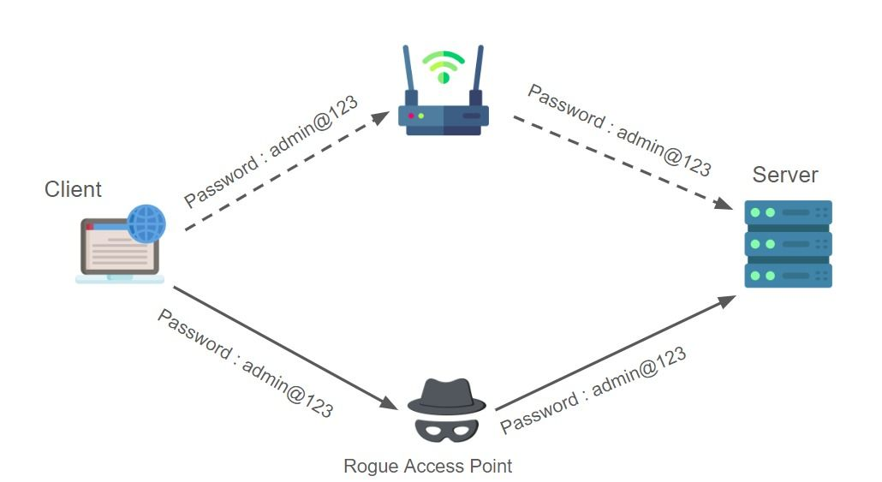
How Do Rogue Access Points Work ?
Placement:
The attacker sets up a wireless AP near the target network or in a public area.
Impersonation:
The rogue AP broadcasts a network name (SSID) similar to a legitimate one.
Victims unknowingly connect to it.
Data Interception:
Once connected, attackers can capture sensitive data like login credentials or banking information.
Access Expansion:
Rogue APs can be used as entry points to the larger network, allowing attackers to install malware.

Slide 6
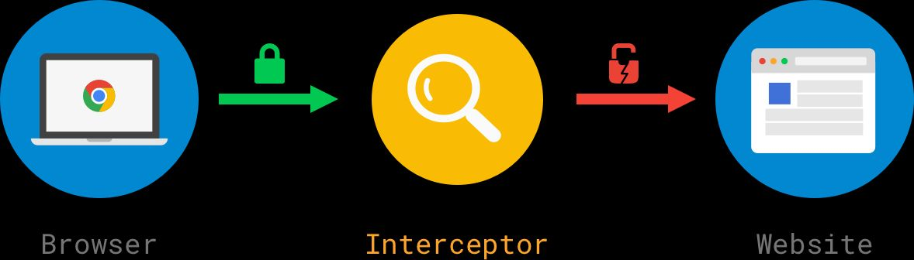
What Is Data Interception ?
Data interception is the unauthorized capture of data as it travels across a network.
Attackers exploit weak encryption, unsecured networks, or vulnerabilities to eavesdrop on sensitive communications.
Key Targets:
Login credentials.
Financial information.
Confidential files or messages.

Slide 7
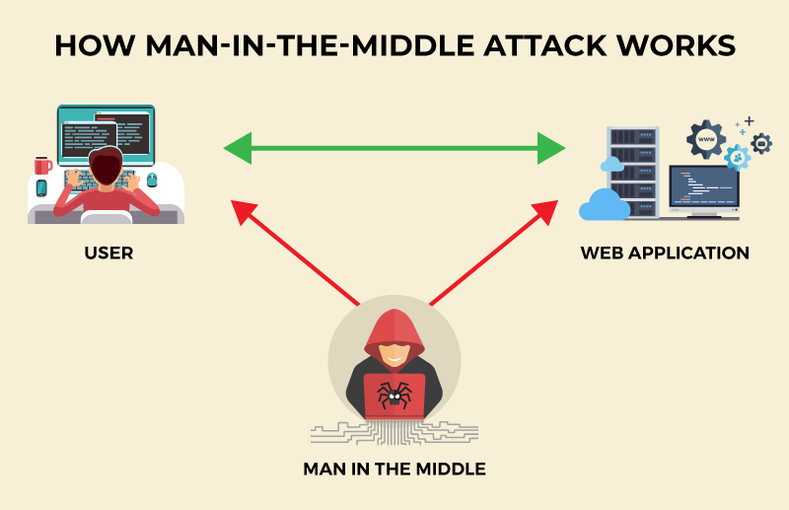
Types of Data Interception Attacks
Packet Sniffing:
Attackers use tools to capture network packets, analyzing them for sensitive data.
Often targets unencrypted networks.
Man-in-the-Middle (MitM) Attack:
The attacker secretly intercepts and relays communication between two parties.
Victims think they are directly communicating with each other.
Wi-Fi Eavesdropping:
Attackers use rogue access points or unsecured public Wi-Fi to intercept data.
Common in cafes, airports, and other public spaces.
SSL Stripping:
Attackers downgrade secure HTTPS traffic to less secure HTTP, exposing sensitive data.

Slide 8



Why Are Rogue APs & Data Interception Dangerous?
Compromise Confidentiality: Sensitive information can be stolen.
Facilitate Identity Theft: Stolen credentials can be used to impersonate victims.
Network Breach: Attackers gain unauthorized access to internal resources.
Financial Loss: Intercepted financial data can lead to fraud.

Slide 9

Real-life Examples of Rogue Access Points
Example 1: Hotel Wifi Attack
Attackers set up a rogue AP named “Hotel Wi-Fi Free.”
Guests connected, and attackers intercepted login details.
Example 2: Coffee Shop Incident
A rogue AP mimicked the shop’s network.
Users’ financial transactions were intercepted.

Slide 10

Signs of a Rogue Access Point
Unusual Network Names (SSIDs):
Slight variations in spelling or capitalization (e.g., “Company WiFi” vs. “CompnyWiFi”).
Slow Network Speeds:
Rogue APs often cause slower connections due to data interception processes.
Frequent Disconnections:
Users may be disconnected from the legitimate network repeatedly.
Unsecured Connection:
No encryption or password requirements.

Slide 11
Defensive Measures Against Rogue APs
Avoid Public Wi-Fi:
Use a personal mobile hotspot whenever possible.
Use Virtual Private Networks (VPNs):
Encrypts data, making it harder to intercept.
Enable Two-Factor Authentication (2FA):
Adds an extra layer of security even if credentials are stolen.
Verify Network Names:
Double-check SSIDs before connecting.
Monitor Connected Devices:
Use tools to scan for unauthorized devices in your network.
Educate Yourself and Others:
Regular training and awareness to recognize signs of rogue APs and data interception.

Slide 12
Defensive Measures Against Data Interception
Use Secure Connections:
Always look for “https://” in the browser.
Update Devices:
Keep software and operating systems up to date.
Secure Wi-Fi Networks:
Use strong passwords and enable WPA3 encryption on home routers.

Slide 13
Activity
Information falling in wrong hands can have devastating effects on people .
One way to avoid such leak is encryption .
Encrypting data can help us safeguard against people with malicious intent

Slide 14


PYTHON PRACTICAL ACTIVITY ( Code Link )
Practical Activity # 1 (Rogue Access Point Name Scanner)
Practical Activity # 2 (Fake Access Point SSID Detector (Pattern Matching))
Practical Activity # 3 (Simulated Man-in-the-Middle (MitM) Alert)
Practical Activity # 4 (Packet Sniffing Simulation using Scapy)
Practical Activity # 5 (HTTPS vs HTTP URL Checker)

Slide 15
Practical Activity # 1 (Rogue Access Point Name Scanner)
🔐 Demonstrates how unauthorized or suspicious Wifi SSIDs can be detected by scanning local networks for misleading names.
import subprocess
def scan_wifi_networks():
print("📶 Scanning for nearby Wi-Fi networks...\n")
result = subprocess.run(["nmcli", "-f", "SSID,SIGNAL", "dev", "wifi"], capture_output=True, text=True)
print(result.stdout)
scan_wifi_networks()

Slide 16
Practical Activity # 2 (Fake Access Point SSID Detector (Pattern Matching))
🔐 Demonstrates how minor variations in SSIDs can be used by attackers to impersonate legitimate networks and trick users.
def detect_fake_ssids(available_ssids):
legitimate = "CompanyWiFi"
flagged = []
for ssid in available_ssids:
if ssid.lower().replace(" ", "") != legitimate.lower():
flagged.append(ssid)
return flagged
# Usage SSID list
ssids = ["CompanyWiFi", "CompnyWiFi", "Company Wifi", "CompanyWiFi_Free"]
suspicious = detect_fake_ssids(ssids)
print("⚠️ Suspicious SSIDs detected:", suspicious)

Slide 17
Practical Activity # 3 (Simulated Man-in-the-Middle (MitM) Alert)
🔐 Demonstrates how attackers intercept communications between two parties, exposing credentials or sensitive messages.
def mitm_simulator():
print("👥 Simulating Man-in-the-Middle scenario...")
print("Alice → [ Attacker intercepts ] → Bob")
print("Attacker captures login credentials or modifies messages.")
print("🚨 WARNING: Public Wi-Fi networks without encryption are highly vulnerable to MitM attacks.")
mitm_simulator()

Slide 18
Practical Activity # 4 (Packet Sniffing Simulation using Scapy)
🔐 Demonstrates how attackers can capture raw network packets to analyze unencrypted data traffic for potential leaks.
🛑 Note: Requires root/admin privileges and is intended for educational lab environments only.
from scapy.all import sniff
def packet_callback(packet):
print(f"📦 Packet: {packet.summary()}")
print("🛜 Starting packet sniffing (Press Ctrl+C to stop)...")
sniff(prn=packet_callback, count=10)

Slide 19
Practical Activity # 5 (HTTPS vs HTTP URL Checker)
🔐 Demonstrates how unencrypted web traffic using HTTP can be intercepted or downgraded by attackers using SSL stripping techniques.
def check_url_security(url):
if url.startswith("https://"):
print("✅ Secure connection detected.")
elif url.startswith("http://"):
print("❌ Insecure connection detected – vulnerable to SSL stripping!")
else:
print("❓ Unknown protocol.")
# Usage URLs
urls = ["https://bank.com", "http://bank-login.com"]
for u in urls:
check_url_security(u)

Slide 20


Exercise
1. What is the main goal of a rogue access point in a cyber attack? A) To improve network speed for users B) To help users find free internet connections C) To trick users into connecting and steal sensitive data D) To create new Wi-Fi passwords for companies Answer: C
2. Which of the following best describes a Man-in-the-Middle (MitM) attack? A) Encrypting messages with a public key B) Sending bulk spam emails C) Intercepting and altering communication between two users D) Blocking all incoming connections to a router Answer: C

Slide 21
Exercise
3. What is a common sign of a rogue access point? A) VPN service prompts B) SSIDs with unusual names or slight spelling changes C) Software update notifications D) Fast and stable internet performance Answer: B
4. Which method helps protect against data interception on public networks? A) Using weak passwords B) Connecting only to open Wi-Fi networks C) Using a Virtual Private Network (VPN) D) Avoiding all internet usage Answer: C
5. What does SSL stripping do in a cyber attack? A) Blocks users from accessing secure websites B) Encrypts all browser cookies C) Downgrades HTTPS to HTTP, exposing data D) Prevents antivirus software from updating Answer: C

Slide 22
Conclusion
Rogue access points and data interception are significant cybersecurity threats.
They exploit weaknesses in network security and human behavior.
Awareness, proper tools (like VPNs), and secure practices can significantly reduce risks.

